Slide 1
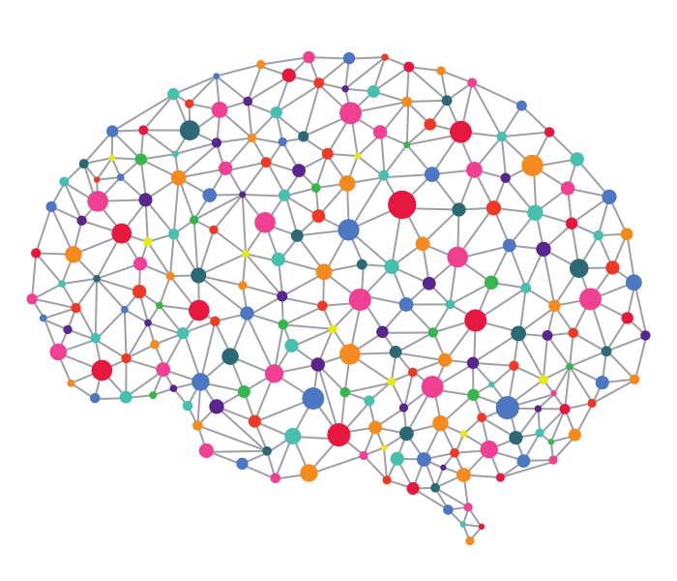




Neural Network neuroscience: OUR TEAM:
ORHAN SOYUHOŞ
MICOL GEMIGNANI
GABRIELE PENAZZI

Slide 2
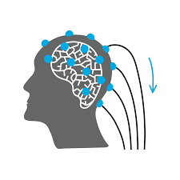
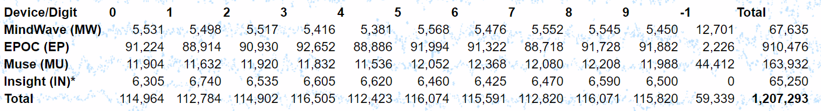
Neural Network neuroscience: A SNEAK PEAK OF OUR PROJECT:
COULD WE PREDICT WHETHER WE ARE BEING PRESENTED WITH A NUMBER?
WHAT’S WORTH KNOWING:
Dataset source: http://www.mindbigdata.com/opendb/

Slide 3
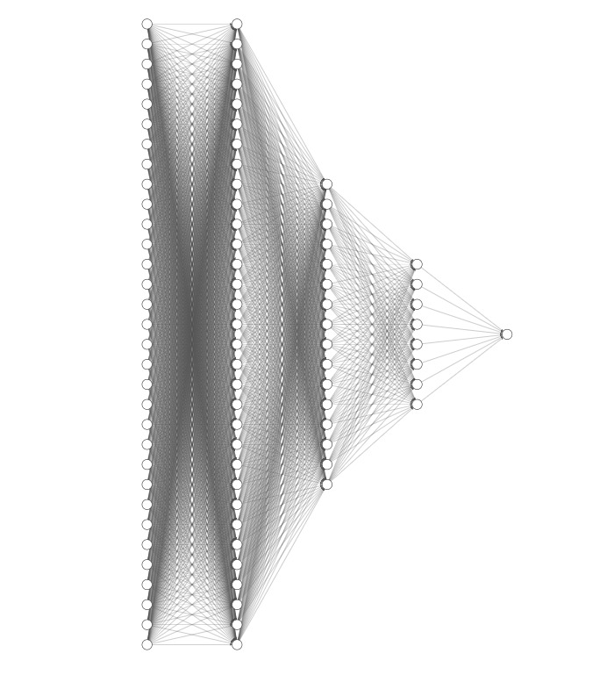
Neural Network neuroscience: GOING DEEPER:
NN’S ARCHITECTURE:
3 HIDDEN LAYERS (256, 128, 64)

Slide 4
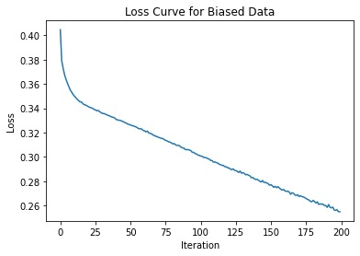
Neural Network neuroscience: A SNEAK PEAK OF OUR RESULTS:
BUT…
Biased data, ACC=89.95 for test set

Slide 5
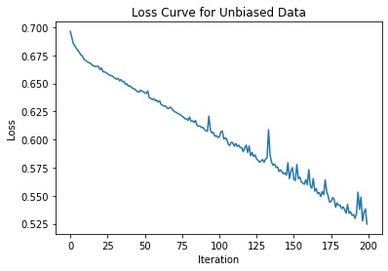
Neural Network neuroscience: AFTER CHECKING THE DATA:
Unbiased data, ACC=75.11 for test set
QUALITY OVER QUANTITY!

